Slide 1
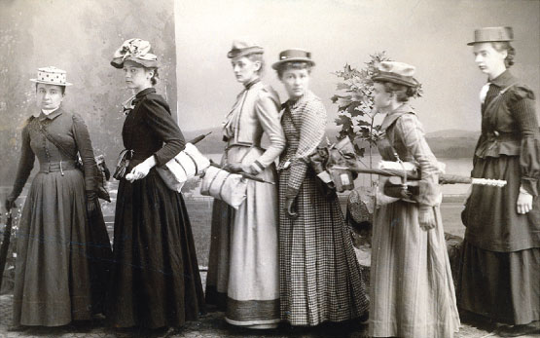
Important figures in Women’s history

Slide 2
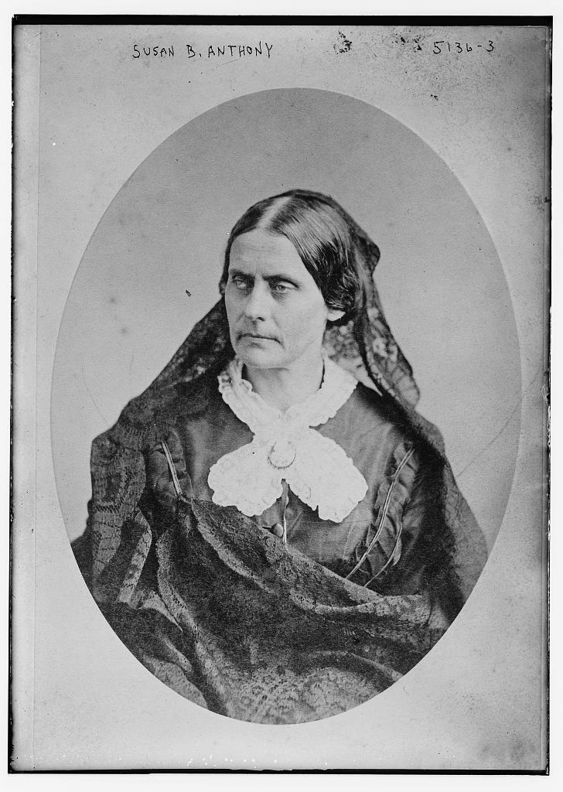
Susan B. Anthony
Wanted the abolition of slavery, women to own their own property, and retain earnings
Advocated women’s labor organizations
Founded American equal rights association
Claimed the constitution gave her the right to vote, and she gets fined
Talked about being prolife

Slide 3
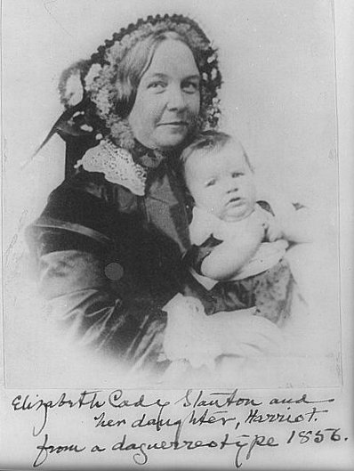
Elizabeth Cady Stanton
Married to Henry Brewster Stanton in 1840
She had seven children
Aided in the Property Rights of Married women
Writings- The Woman's Bible Eighty Years & More: Reminiscences 1815-1897(1898) The Solitude of Self

Slide 4
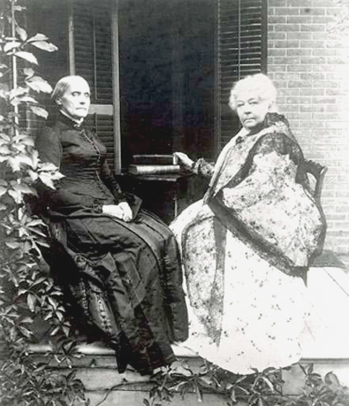
Susan and Elizabeth
Founded The Woman's State Temperance Society (1852-1853)
Posted a weekly periodical,
Revolution
1869, Anthony and Stanton
formed the National Woman
Suffrage Association
Stanton was mainly the
writer and Anthony was mostly the thinker

Slide 5
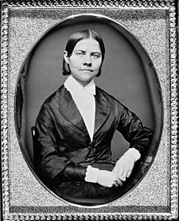
Lucy Stone
Was a public speaker, abolitionist, and suffragist
First woman in Massachusetts to earn a college degree
After married kept maiden name opposed to taking her husband’s
Founded and promoted weekly periodical, Woman’s Journal

Slide 6
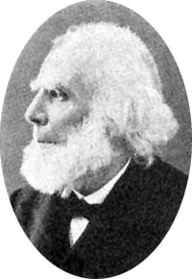
Henry Blackwell
Married to Lucy Stone
One of the founders of the Republican Party
Helped Lucy when he could
Main male supporter
Blackwell earned a living selling
books, sugar refining, and real
estate.
Later he worked against deportation
of political refugees

Slide 7
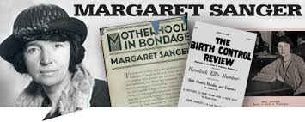
Margaret Sanger
Believed that women and couples had the right to plan parenthood
Opened the first birth control clinic in the United States and was soon arrested for it
In 1918 Judge Frederick Crane appealed her case, allowing Sanger to prescribe contraceptives

Slide 8
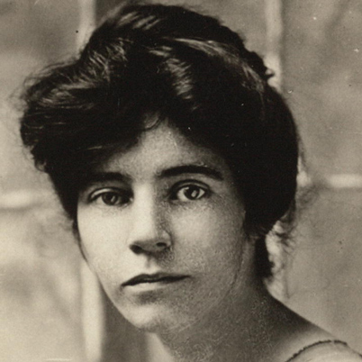
Alice Paul
Used strategies such as hunger strikes and marches to get her point across
Arrested seven times in Britain due to her protests
Founded National’s Women
Party in 1916
Paul and the NWP later
preformed the first picket of the
White House

